Slide 1



ecx.io Frontend Bootcamp — CSS Day 3 06.07.2021.

Slide 2



Introduction round

Slide 3
Agenda
Layout
Normal flow
Overflow
Display property
Float
Table
Flexbox
Grid

Slide 4
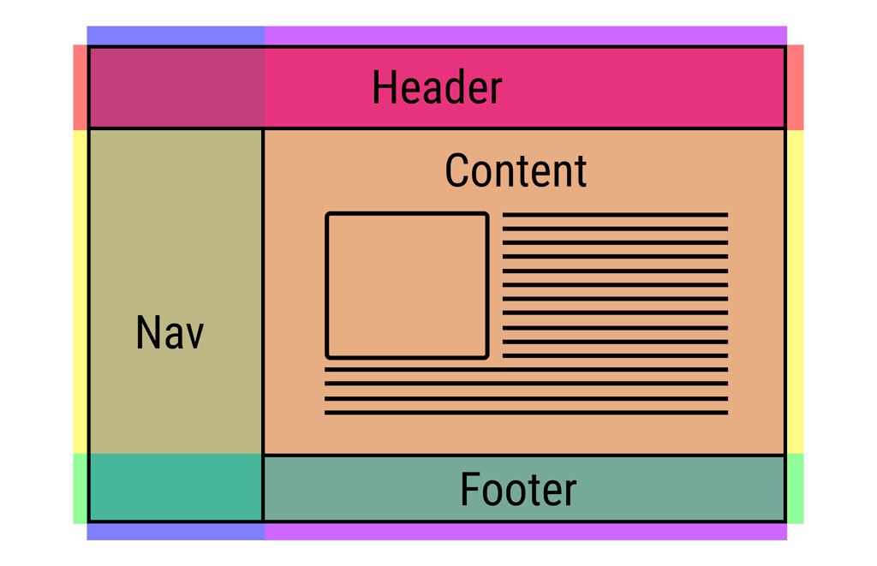
Layout
Once you can target HTML elements for styling, the layout is the next core concept to master.
CSS page layout techniques allow us to take elements contained in a web page and control where they are positioned relative to their default position.

Slide 5
Normal flow

Slide 6
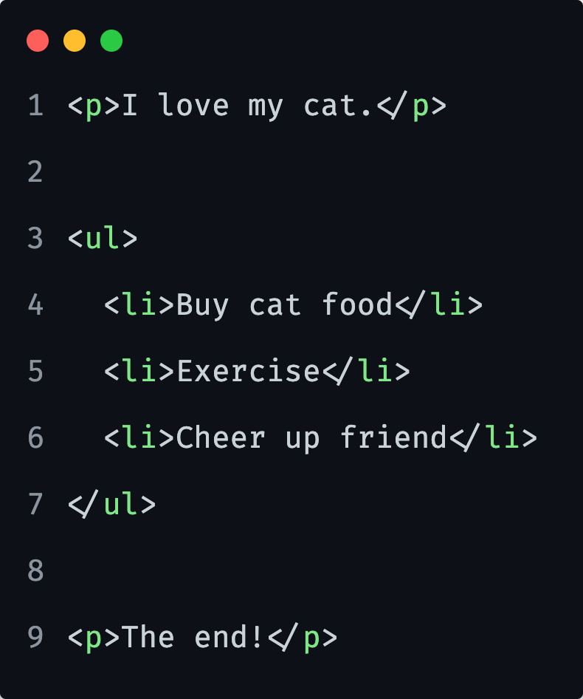
Normal flow
Normal flow is how the browser lays out HTML pages by default when you do nothing to control page layout.

Slide 7
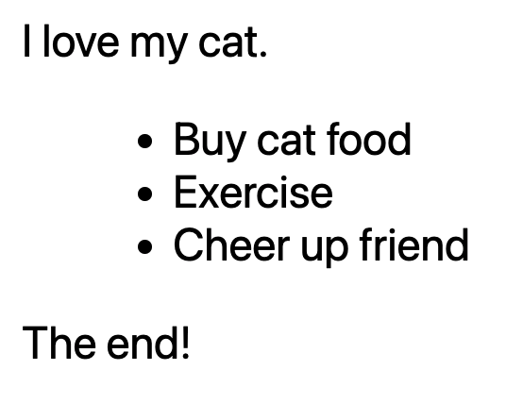
Normal flow
Notes:
HTML is displayed in the exact order in which it appears in the source code, with elements stacked up on top of one another — the first paragraph, followed by the unordered list, followed by the second paragraph.

Slide 8
Normal flow
For many of the elements on your page the normal flow will create exactly the layout you need, however for more complex layouts you will need to alter this default behavior.
Notes:
Starting with a well-structured HTML document is very important, as you can then work with the way things are laid out by default rather than fighting against it.
A11y should also be considered.

Slide 9
Normal flow
Methods that can change how elements are laid out in CSS:
Display property
Floats
Position property we will talk more about that later
Table layout
Multi-column layout

Slide 10
Overflow

Slide 11
Overflow
The CSS overflow property controls what happens to content that is too big to fit into an area.
Notes:
This is important concept to know when dealing with fixed size elements.
If for example a text is really long and the height of its container is only 100 pixels. Therefore, a scrollbar is added to help the reader to scroll the content.

Slide 12
Overflow
The CSS overflow property controls what happens to content that is too big to fit into an area.
Notes:
We might have a container with a fixed size…

Slide 13
Overflow
The CSS overflow property controls what happens to content that is too big to fit into an area.
Notes:
..with too much content inside this container.
That is when overflow happens.

Slide 14
Overflow
The CSS overflow property controls what happens to content that is too big to fit into an area.
Notes:
By setting a overflow property on the container, we prevent the content to overflow.

Slide 15
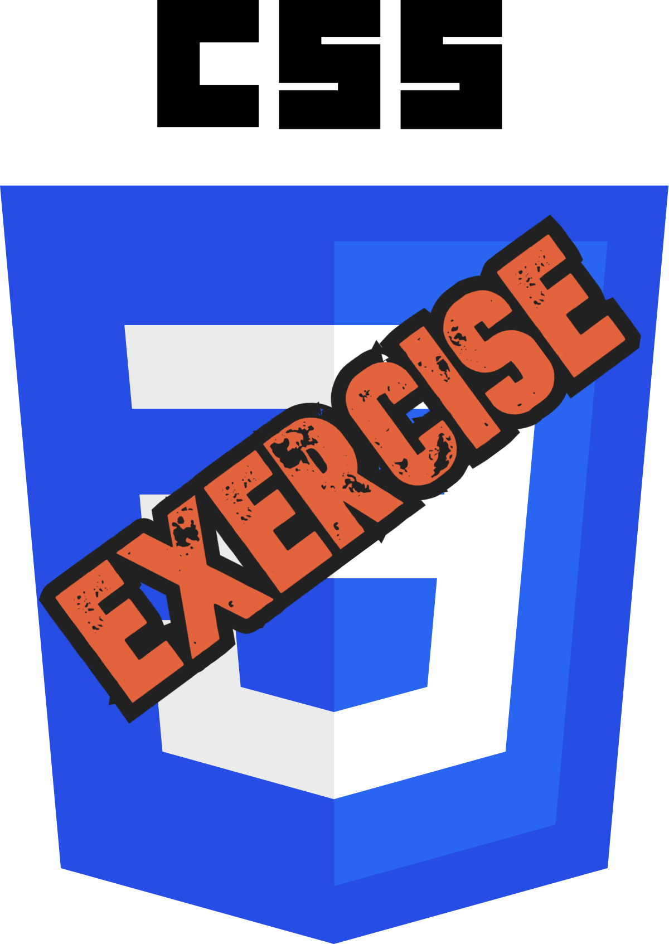
Let’s take a look at Overflow in a Browser.

Slide 16
Display property

Slide 17
Display property
Is CSS's most important property for controlling layout.
Every element has a default display value depending on what type of element it is.
The default for most elements is usually block or inline.
Notes:
A block element is often called a block-level element. An inline element is always just called an inline element.

Slide 18
Display property
Block level elements examples
<p>,
<ol>, <ul>, <dl>
<h1>, <h2>…<h6>
<div>, <article>, <section> …
Inline elements examples
<a>
<strong>, <em>, <b>, <i>, <q>, <mark>
<span>
Notes:
The elements that appear one below the other are described as block elements, in contrast to inline elements, which appear one beside the other, like the individual words in a paragraph.

Slide 19
Display property
A block-level element starts on a new line and stretches out to the left and right as far as it can.
An inline element can wrap some text inside a paragraph <span> like this </span> without disrupting the flow of that paragraph.
Notes:
Setting the width of a block-level element will prevent it from stretching out to the edges of its container to the left and right.
Then, you can set the left and right margins to auto to horizontally center that element within its container.
The element will take up the width you specify, then the remaining space will be split evenly between the two margins.
Using max-width instead of width in this situation will improve the browser's handling of small windows. This is important when making a site usable on mobile.

Slide 20
Display property
Another common display value is none.
It is commonly used with JavaScript to hide and show elements without really deleting and recreating them.
Notes:
This is different from visibility. Setting display to none will render the page as though the element does not exist. visibility: hidden; will hide the element, but the element will still take up the space it would if it was fully visible.

Slide 21
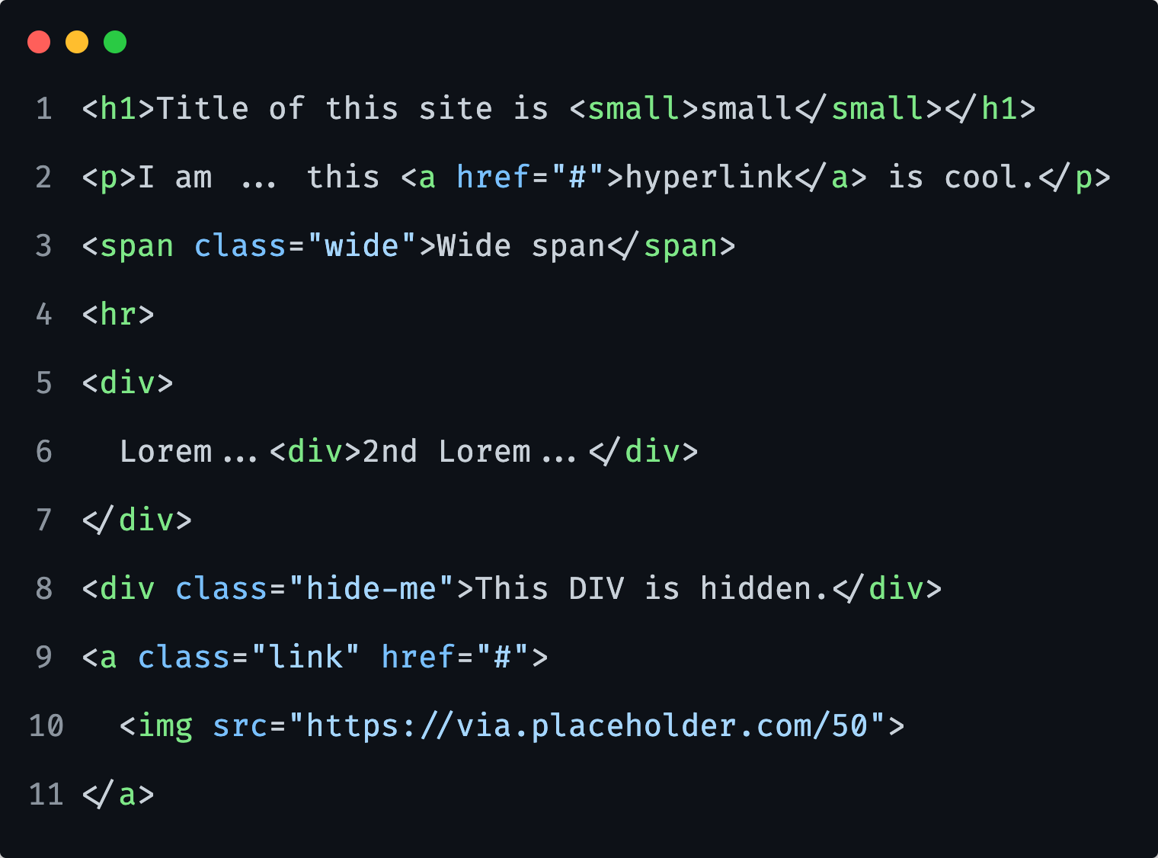
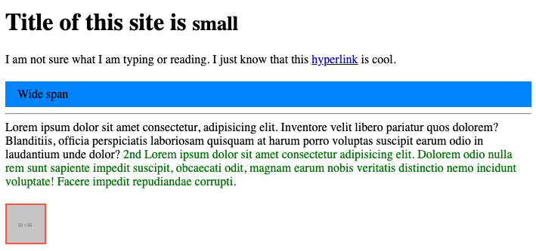
CSS Exercise
Notes:
Let them do it first alone, give them 15m.
Stash reference: 02-Display-property/exercise/index.html

Slide 22
Float

Slide 23
Float
Floating an element changes the behavior of that element and the block level elements that follow it in normal flow.
Notes:
One of the techniques for creating layouts.
Was used primarily also for Grids before: flex and grid came along. But now has returned back to its original usage plan.

Slide 24
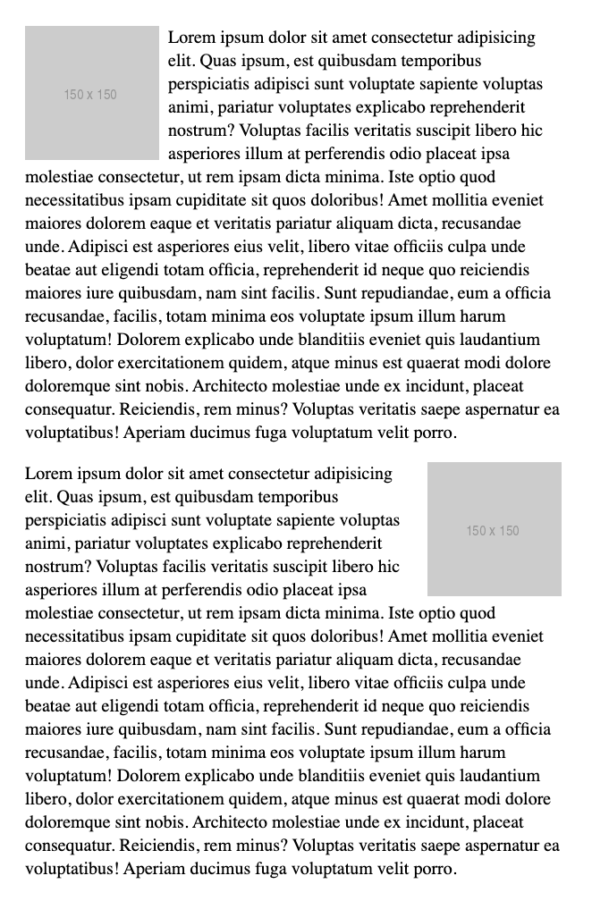
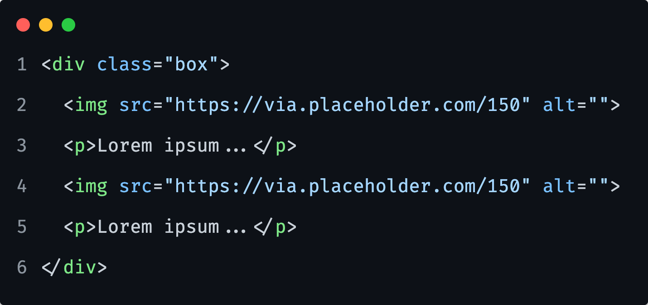
Float
Floating an element changes the behavior of that element and the block level elements that follow it in normal flow.
Was introduced to allow image floating inside a column of text.
Notes:
The kind of thing you might get in a newspaper layout.

Slide 25
Let’s take a look at Float in a Browser.
Notes:
Stash reference: float-example-guidelines.md

Slide 26
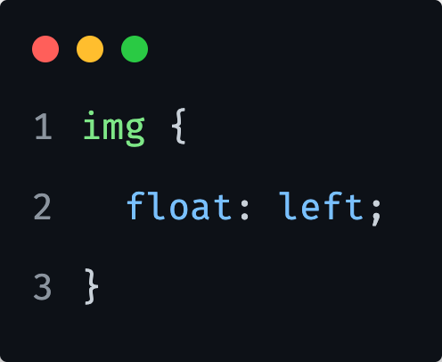
Float
The float property
left floats the element to the left
right floats the element to the right
none specifies no floating at all. This is the default value

Slide 27
Float
Clearing floats
The value of the property clear specifies the side on which the floating element is not supposed to float.

Slide 28
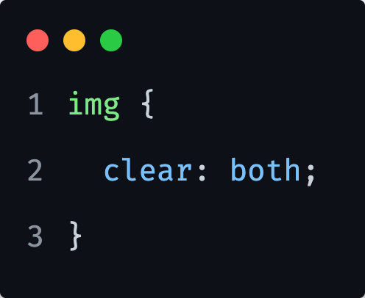
Float
The clear property
left clears the left floating
right clears the right floating
both clears both left and right floating (best practice)

Slide 29
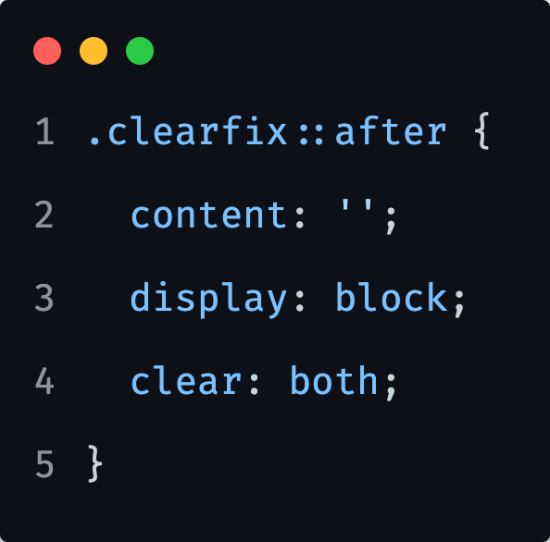
Float
.clearfix
As a best practice, we create a clearfix class to store clearing of the float styles.
We can reuse it enywhere on our site where we require float clearing.
Notes:
Most likely same naming is used across multiple different CSS frameworks, or similar like ”clear” or “cf”…

Slide 30
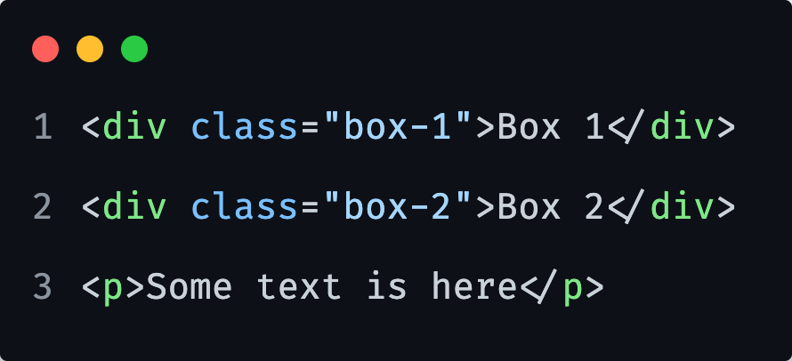
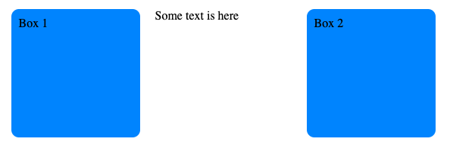
1) Make the 2 boxes float, one on the left and other on the right side.
Notes:
Let them do it first alone, give them 10m.
body {
margin-inline: auto;
max-width: 600px;
}
[class^="box-"] {
width: 150px;
height: 150px;
margin: 0 20px;
padding: 10px;
border-radius: 10px;
background: dodgerblue;
}
.box-1 {
float: left;
}
.box-2 {
float: right;
}

Slide 31
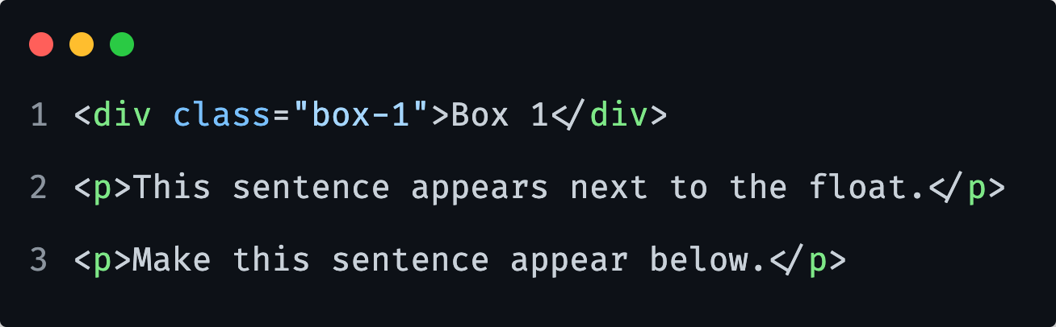
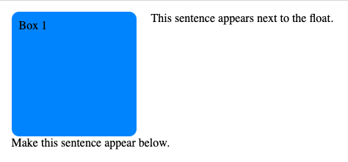
2) Make the first paragraph sit next to the box and other below it.
Notes:
Let them do it first alone, give them 5m.
body {
margin-inline: auto;
max-width: 600px;
}
[class^="box-"] {
width: 150px;
height: 150px;
margin: 0 20px 0 0;
padding: 10px;
border-radius: 10px;
background: dodgerblue;
}
.box-1 {
float: left;
}
p:last-of-type {
clear: both;
}

Slide 32
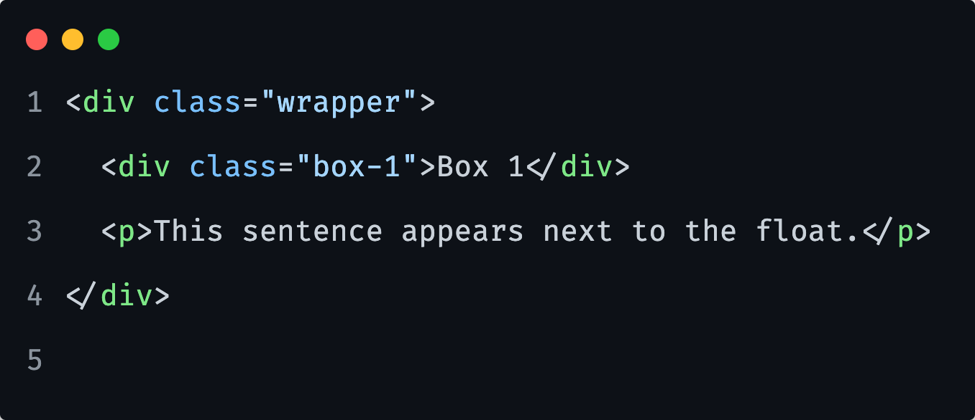
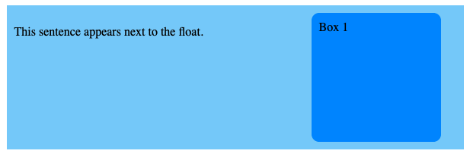
3) Replicate below styles with following markup and make the lightblue background take entire height.
Notes:
Let them do it first alone, give them 5m.
body {
margin-inline: auto;
max-width: 600px;
}
[class^="box-"] {
width: 150px;
height: 150px;
margin: 0 20px 0 0;
padding: 10px;
border-radius: 10px;
background: dodgerblue;
}
/* .wrapper {
background: lightcyan;
padding: 10px;
}
.wrapper::after {
content: '';
clear: both;
display: block;
}
.box-1 {
float: right;
} */

Slide 33
Table

Slide 34
Tables
When to use them?
When you are listing any kind of data that actually makes sense to be inside a table (price listings, price comparisons, employee data etc…)
When to not use them?
Layout.
Notes:
What kinds of things are appropriate in tables? Here are some: a plan/pricing/features comparison, bowling scores, an internal grid of employee data, financial data, a calendar, the nutrition facts information panel, a logic puzzle solver, etc.
An inappropriate use for tables is for layout. That may seem counter-intuitive. At a glance at how tables work may make them seem ideal for layout. Easy to control, extremely logical, predictable, and not-at-all fragile.

Slide 35
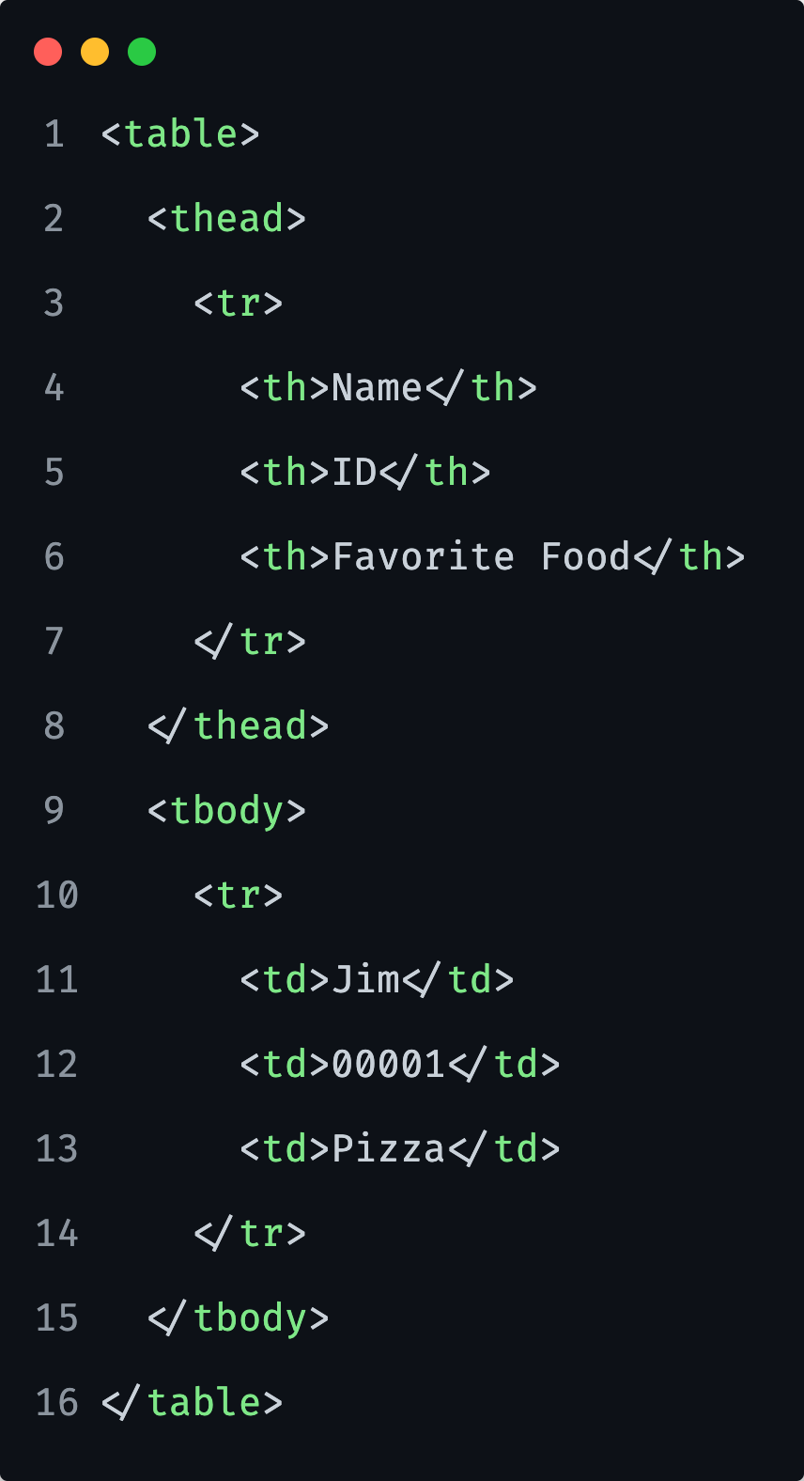
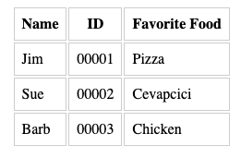
Table
Notes:
Notice the slight gap between the rowst.
That is caused by the default border-spacing and border-collapse, being applied by the browser.
Best way to remove it is to set the `border-collapse` to `collapse`, so borders collapse to one and we have only 1 line.

Slide 36
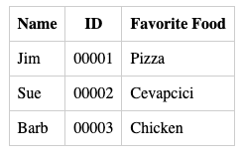
Table
Notes:
Now the image with border collapse.

Slide 37
Let’s take a look at Table in a Browser.

Slide 38
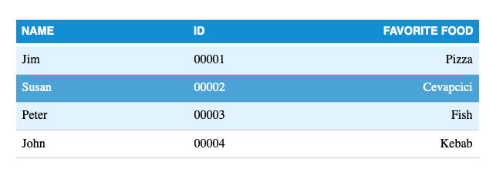
Recreate a following table.
Notes:
Give them 20 minutes.
Also provide HTML, as the main focus should be on CSS.
The 2nd line in table tbody shows hover styles.
Stash reference: 04-Table/example/table-example-guidelines.md

Slide 39
Flexbox

Slide 40
Flexbox
Flexible Box Layout
Flexbox is a one-dimensional layout method for laying out items in rows or columns.
Items flex to fill additional space and shrink to fit into smaller spaces.
Notes:
For a long time, the only reliable cross browser-compatible tools available for creating CSS layouts were things like floats and positioning.
These are fine, and they work, but in some ways they are also rather limiting and frustrating.
The following simple layout requirements are either difficult or impossible to achieve with such tools, in any kind of convenient, flexible way:
- Vertically centering a block of content inside its parent.
- Making all the children of a container take up an equal amount of the available width/height, regardless of how much width/height is available.
- Making all columns in a multiple-column layout adopt the same height even if they contain a different amount of content.

Slide 41
Let’s take a look at Flexbox in a Browser.
Notes:
Stash reference: flexbox-example-01-guidelines.md

Slide 42
Flexbox
AXES
To align items, we need to understand concept of AXES in Flex.
We have Main axes and Cross axes.
The axes change as we change the flex-direction!
Main
Direction: row
Cross
Cross
Direction: column
Main

Slide 43
Flexbox
Aligning items
justify-content over the main axis
align-items over the cross axis
align-content multiple lines of content
Notes:
Most of the time, we use only first two: justify-content and align-items.

Slide 44
Flexbox
align-items over the cross axis
flex-start set flex items from the start
flex-end set flex items from the end
baseline items on the line are aligned such that their baselines align, and the item with the largest distance between its baseline and its cross-start margin edge is placed flush against the cross-start edge of the line
stretch (default) items are stretched such that the cross-size of the item's margin box is the same as the line while respecting width and height constraints

Slide 45
Flexbox
justify-content over the main axis
space-around distribute items evenly, items have a half-size space on either end
space-evenly distribute items evenly, items have equal space around them
space-between first is placed at very start, last at very end, and all in the middle are equally distributed with equal space between them
Notes:
Some of the other values we can set: flex-start | flex-end | center | start | end | left | right
Difference between `flex-start` and `start`
start: items are packed toward the start of the writing-mode direction.
flex-start (default): items are packed toward the start of the flex-direction.
In flexbox, the axises can change, where in grid they cannot. That effects things like flexbox having values like flex-start where in grid it is just start.

Slide 46
Back to the Browser.
Notes:
Stash reference: flexbox-example-01-guidelines.md
Point 6

Slide 47
Flexbox
flex-wrap
Allows items in our flex container to fall into another row.

Slide 48
Flexbox
align-self
Is a property we apply on flex item, and not flex container.
With it, we can override the value assigned earlier on container with align-items property.

Slide 49
Flexbox
justify-self
Is a property we apply on flex item, and not flex container.
With it, we can override the value assigned earlier on container with justify-content property.

Slide 50
Flexbox
Sizing items
flex-basis the initial size of a flex item
flex-grow the growth factor
flex-shrink the shrink factor
flex the shorthand for all above 3 properties
Notes:
All this properties should be applied on flex items, and not flex container.

Slide 51
Back to the Browser.
Notes:
Stash reference: flexbox-example-01-guidelines.md
Point 14

Slide 52
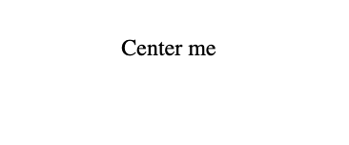
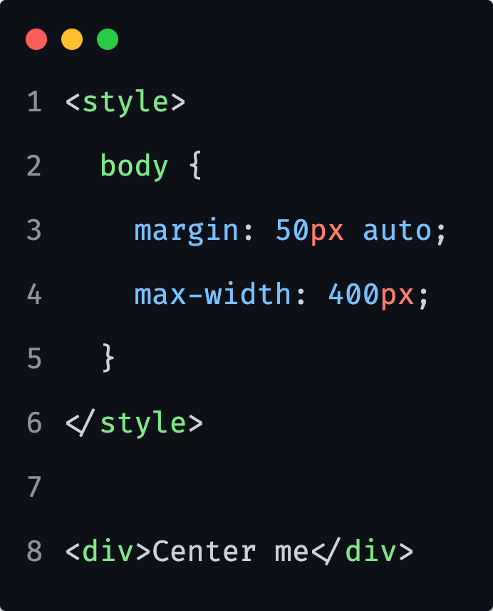
Recreate following
Notes:
Give them 5 minutes.
div {
display: flex;
align-items: center;
justify-content: center;
}

Slide 53

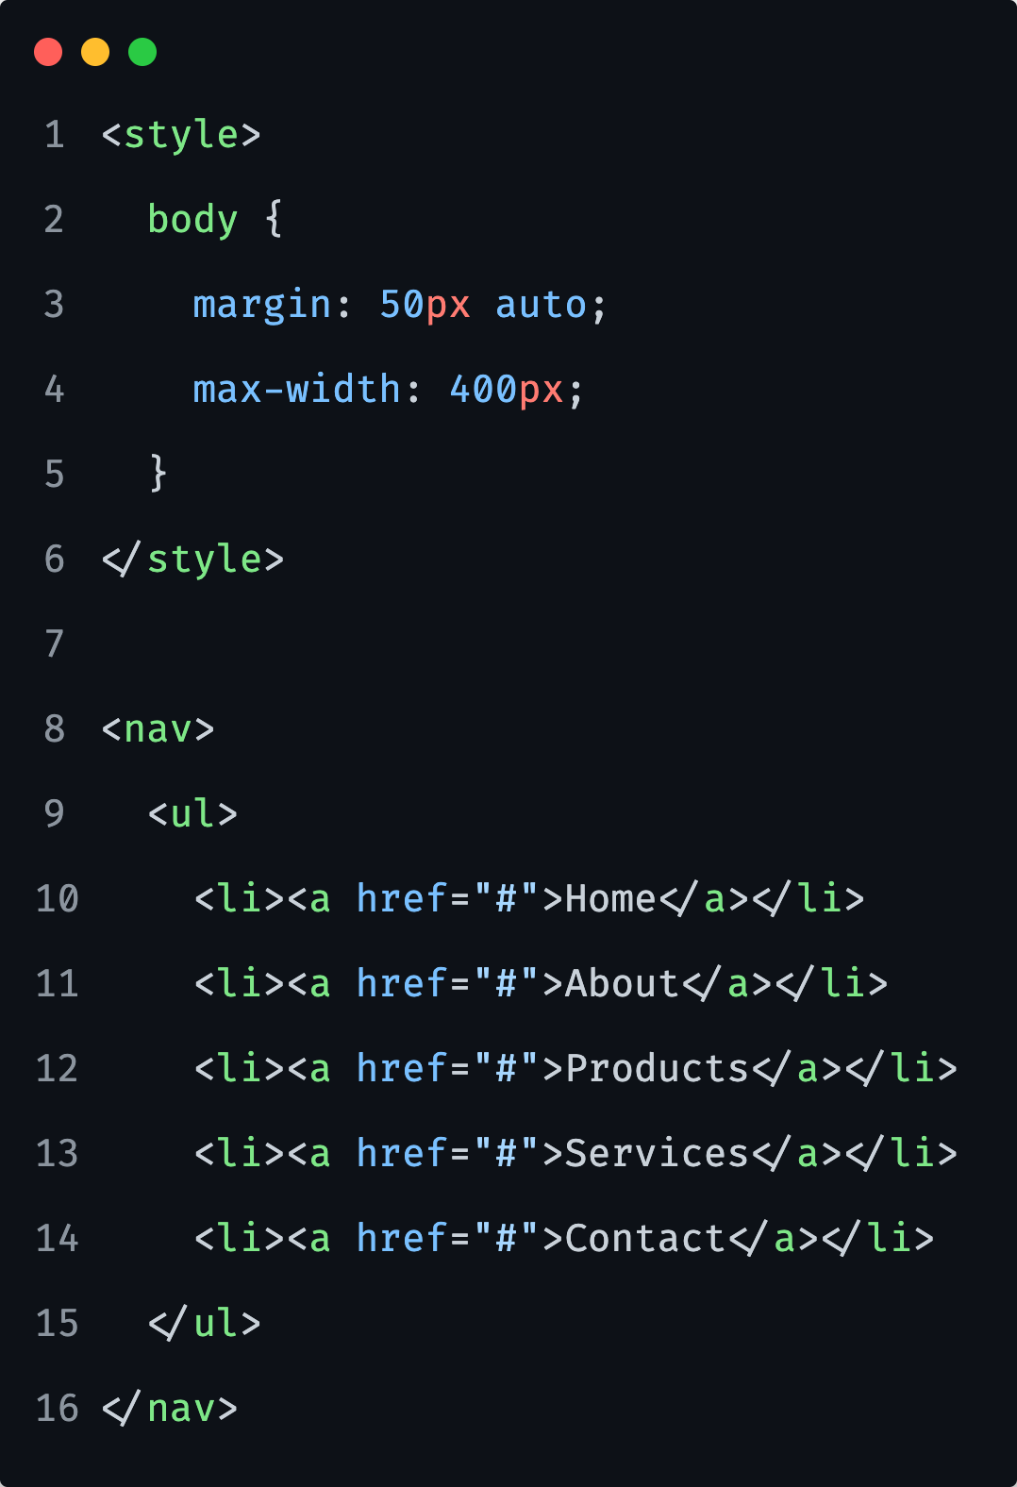
Recreate following
Notes:
Give them 10 minutes.
/* ul {
list-style: none;
margin: 0;
padding: 0;
}
ul {
display: flex;
justify-content: space-between;
} */

Slide 54
https://flexboxfroggy.com/
Notes:
30 minutes exercise

Slide 55
Reference links

Slide 56

Reference links
Layout
https://developer.mozilla.org/en-US/docs/Learn/CSS/CSS_layout/Introduction
Float
https://developer.mozilla.org/en-US/docs/Learn/CSS/CSS_layout/Floats
https://css-tricks.com/all-about-floats/
Tables
https://developer.mozilla.org/en-US/docs/Learn/CSS/Building_blocks/Styling_tables
Flexbox
https://css-tricks.com/snippets/css/a-guide-to-flexbox/
https://developer.mozilla.org/en-US/docs/Learn/CSS/CSS_layout/Flexbox
https://flexboxfroggy.com/

